Slide 1


Using ChatGPT for programming help

Slide 2

Should you use AI tools in this course?
Yes!
But be careful that it does not get in the way of your learning

Slide 3
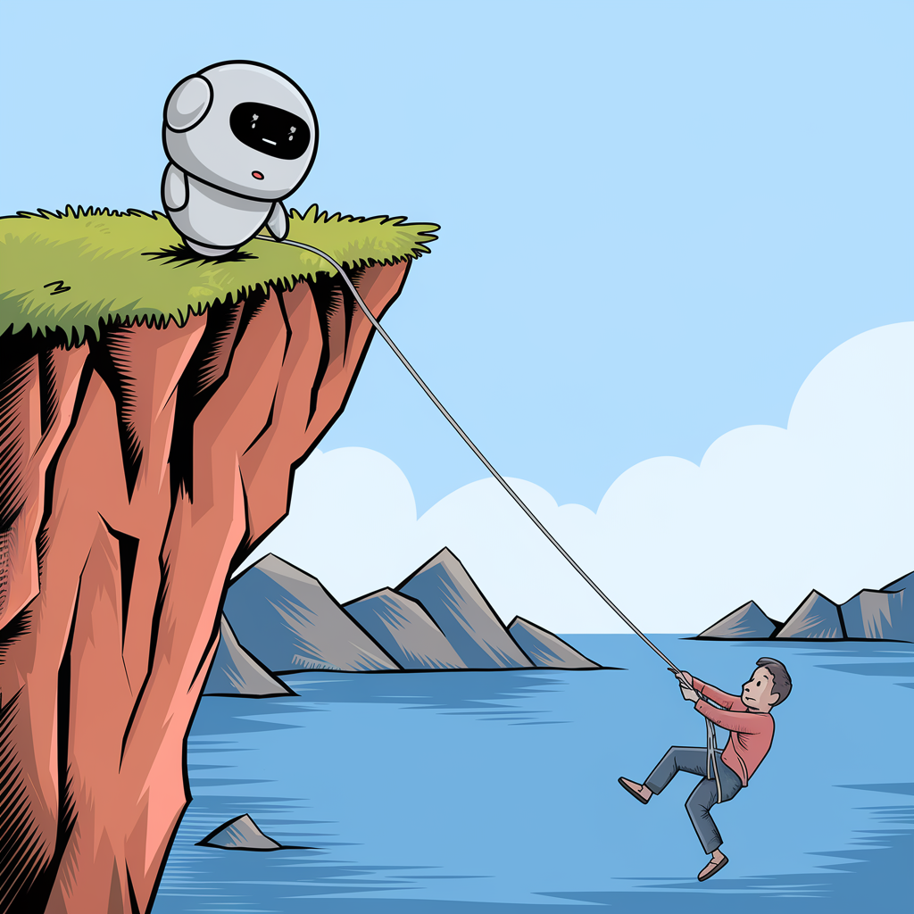
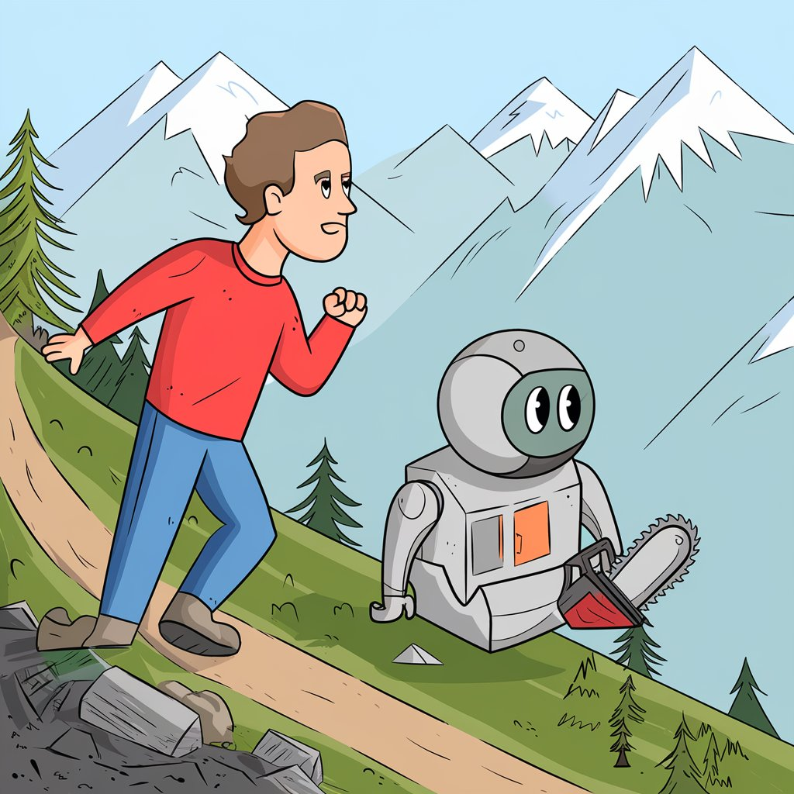
LLMs are a useful tool, but you need to learn the terrain
AI can bring you to baseline quickly.
No more getting stuck for 5 hours on easy bugs!
Once you are proficient, AI is a very helpful intern..
But you need expertise to direct, lead supervise! Otherwise, you’ll end up stuck in a ditch eventually.

Slide 4
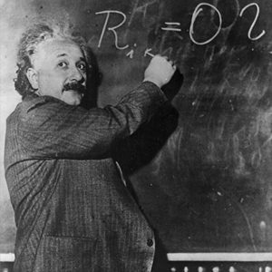



Should children learn how to do arithmetic?

Slide 5


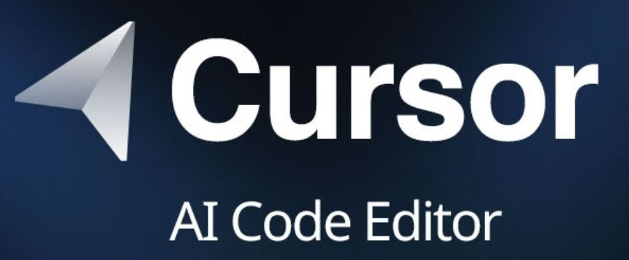

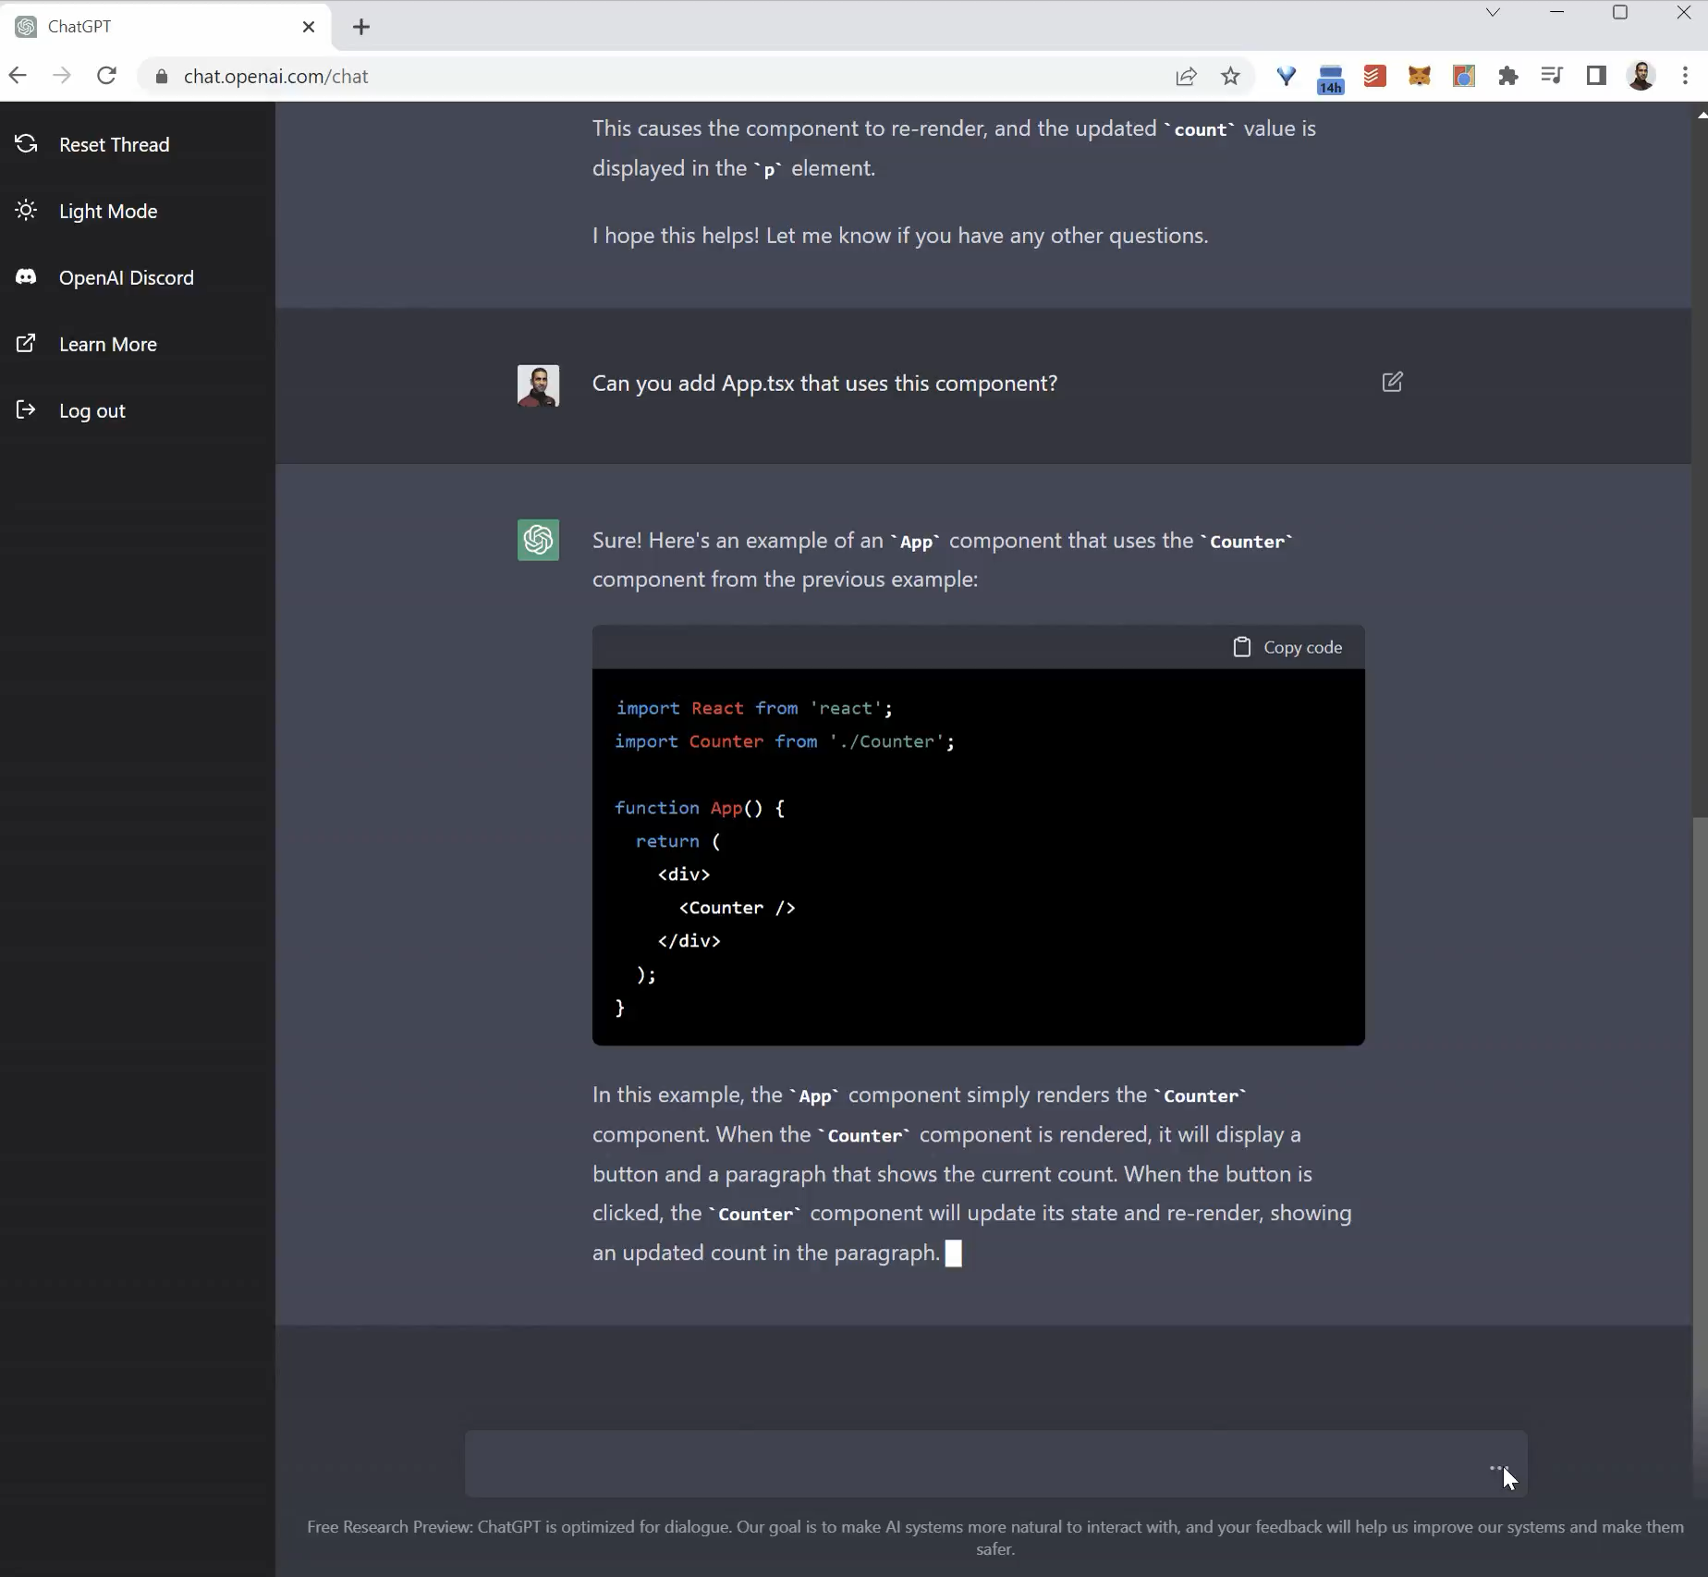
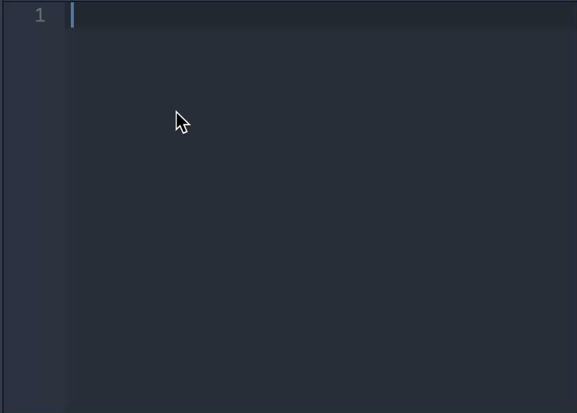
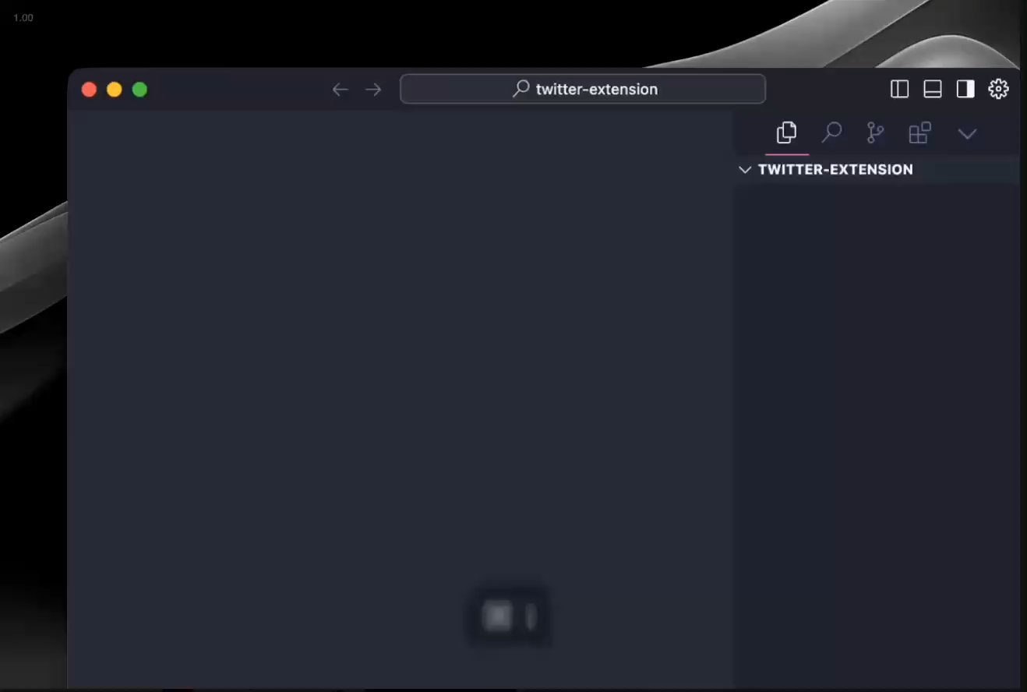
So what tools do we recommend when learning?
Autocomplete
Chat
Coding agent

Slide 6
How to use ChatGPT as a programming learner
Code explanations/clarifications
Code generation (make sure you understand what you copy)
Debugging assistance. You must share
Data
Minimal code example
Expected output
Error/Issue
Notes:
```{python}
people_df = pd.DataFrame(
{
"name": ["Alice", "Bob", "Charlie"],
"age": [25, 30, 28],
"city": ["Lagos", "London", "Lima"],
}
)
people_df
```

